Slide 1

Curriculum Night
5th Grade CTA
Patterson Elementary 2023-2024
Ms. Sterling
Room B9
(480) 224-3669
sterling.christina@cusd80.com
12th year at Patterson
17th year teaching 5th grade
Graduate of ASU… Go Sun Devils!
Two sons: junior at Hamilton and
8th grader at Champion Charter School

Slide 2

School Info. and Reminders
Parent-Teacher Conferences 8/23 & 8/24
No students on campus before 8:15-softstart
Cell phones off and in backpacks (Smart watches off as well)
Students will not be able to call home for homework and/or instruments
Mrs. Edwards – school counselor

Slide 3
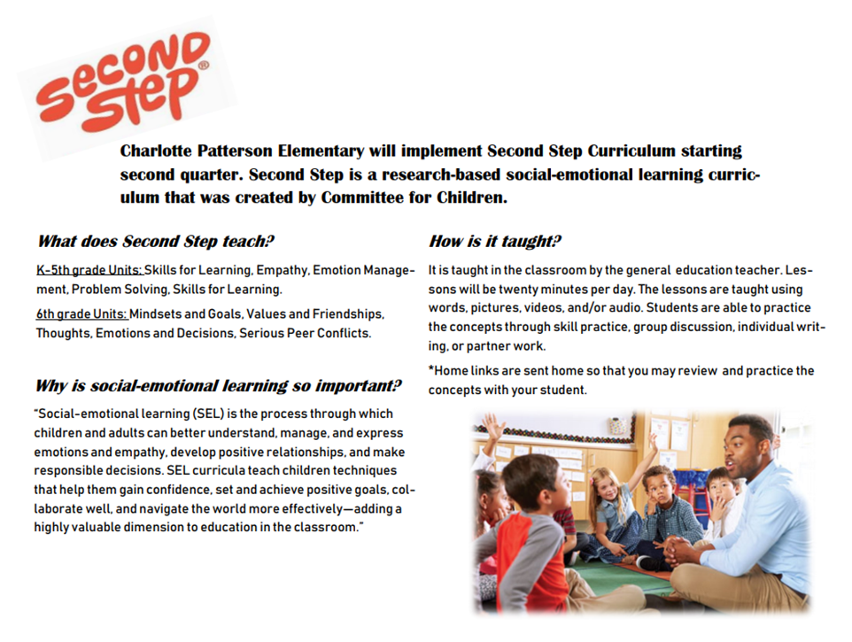

Slide 4

Math
6th Grade Curriculum (McGraw Hill)
  Ratios and Proportional Relationships
  Number System
  Expressions and Equations
  Geometry
  Statistics and Probability
  Cumulative practice and assessment
  Online book accessible through Clever
  *** Students are expected to show work on all assignments and tests
Math Facts
  100 problems in 2 ½ minutes – assessed daily

Slide 5
5th Grade Block Schedule
6-Day Rotation
Library: Day 2 11:00-11:30
Tech Lab: Day 5 11:05-11:45
 | Day 1/4 |  | Day 2/5 |  | Day 3/6
MUSIC CLASSES | Band B |  | Full Band |  | Band A
 | Full Orch |  | Orch A |  | Orch B
 | GMA |  | GMB |  | GMA/B
PE | Band A |  | Orch B |  | Band B
 | GMB |  | GMA |  | Orch A

Slide 6
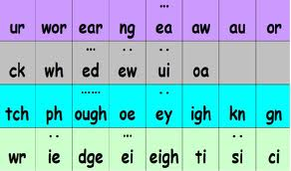
Phonograms
We practice 30 phonograms orally per week.

Slide 7
Spelling
Spelling words are taken from the Extended Ayres word list. We are starting in section “T”.
We input 30 words per week.
Test every Friday on the previous week’s list. (The notebook will always be one week ahead.)

Slide 8

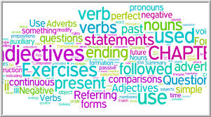
Grammar
Main sources in teaching grammar:
HMH Into Reading 5th Grade
All grammar is reinforced during the writing lesson.

Slide 9
Reading
HMH Into Reading
  Vocabulary in context
  Whole group instruction with comprehension skills and strategies
  Small group instruction
AR
  Independent reading
  STAR test used to assess reading level
  Individual goals set quarterly by teacher
Literature Studies
  The Elephant Keeper: Caring for Orphan Elephants in Zambia
  The One and Only Ivan
  Girls Think of Everything: Stories of Ingenious Inventions by Women
  Where the Mountain Meets the Moon

Slide 10

Writing
Resources
Thinking Maps
Write From the Beginning
HMH Into Reading
**Cursive handwriting is expected for all assignments**
Forms of Writing
Informative-Explanatory
Opinion
Narrative
Research
Poetry
**AASA Rubric used for grading**

Slide 11

Social Science
Geography/Regions
States and Capitals
American History (American Revolution-Civil War)

Slide 12
Science
Properties of Matter
Motion and Forces
Energy
Sun, Moon, and Earth Relationship
Inherited Traits
Defined STEM
**Human Growth and Development lesson at the end of the year

Slide 13

Oral Presentations
Quarterly Recitations
  1 per quarter
  Focus on eye contact, volume, memorization, fluency, and enunciation.
Various assignments
Speaking & Listening grade

Slide 14
Homework
Student Planner
Independent reading at least 20 minutes
Math (Students need to show all work.)
Spelling (www.spellingcity.com)
Unfinished classwork
Approximately 40-60 minutes PLUS reading
Math book access online through Clever

Slide 15
Absent/Missing Work
When your child is absent, they are expected to complete all assignments from that day(s).
Check Infinite Campus weekly for missing assignments.

Slide 16
Graded Work
Infinite Campus – Online gradebook
Graded work will be sent home in Accountability Notebooks periodically throughout the quarter.
Parent initials are required on the assignment log.
The Accountability Notebooks are kept at school.
Class assignments-lower than 70% can be raised to 70% with corrections.
Tests-option of corrections (with help) for up to 70% or independent retake and keep the best of the two scores.

Slide 17
Classroom Management
Responsibility and accountability are key concepts in 5th grade!
Student planner and binder
Homework
-Study Bingo
5th Grade Classroom Economy System

Slide 18
School-wide Discipline Plan
CUSD Handbook used as a guide for all consequences
Ms. McKinley - Dean to handle discipline
Possible Consequences for Misconduct Tickets
  Warning
  Lunch and/or recess detention
  After school detention
  ½ day ISS (In-school suspension)
  Full day ISS
  OSS (Off-school suspension)

Slide 19
Classroom Communication
Daily check-in emails
Thursday Thoughts Newsletter emailed weekly
Patterson Print-sent by email monthly
*Please contact your child’s teacher first with any questions or concerns.

Slide 20


Slide 21


Slide 22


Slide 23


